Slide 1
Version Control. Git + GitHub
</
/>
Repositories
Branches
Pull requests

Slide 2
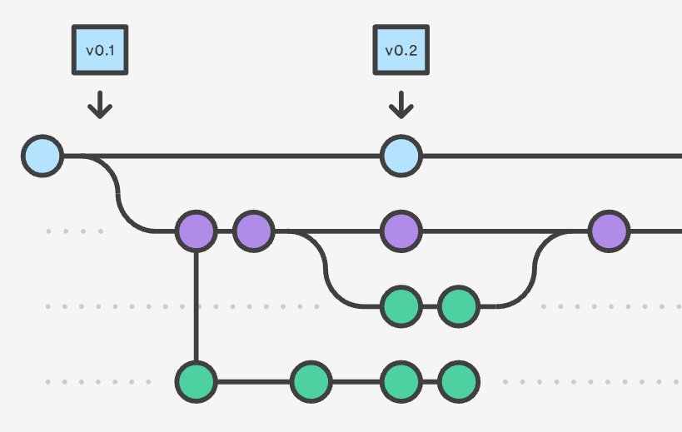
</What are version control systems and why do we need them?
Version control, also known as source control, is the practice of tracking and managing changes to software code.
Version control systems are software tools that help software teams manage changes to source code over time.
Version control systems help software teams work faster and smarter.

Slide 3
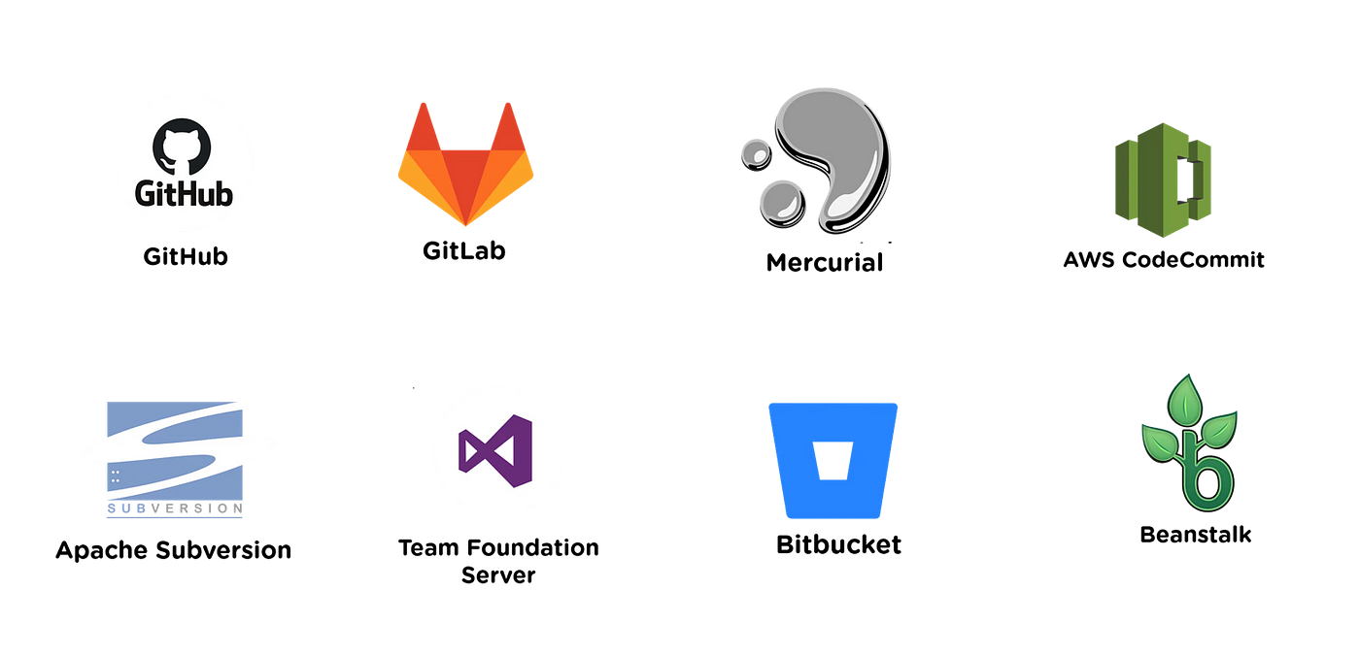
</Examples of version control systems

Slide 4

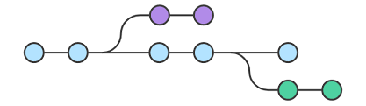
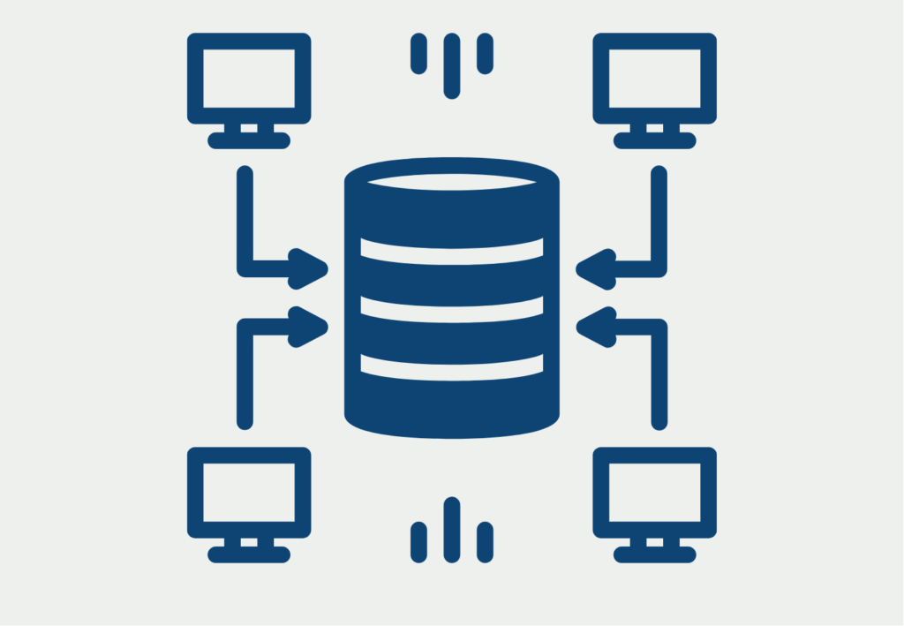
</ GitHub overview
Repositories
{01}
It's a place where you can store your code, your files, and each file's revision history.
Branches
{02}
A parallel version of your code that is contained within the repository but does not affect the primary or main branch.

Slide 5
</ GitHub overview
Commits
{03}
A commit records changes to one or more files in your branch.
Pull Requests
{04}
A pull request is a proposal to merge a set of changes from one branch into another.
Git Flow
{05}
GitHub flow is a lightweight, branch-based workflow.

Slide 6




</ Install Git…
{01}
On Windows
https://git-scm.com/download/win
{02}
On MacOS
https://git-scm.com/download/mac
{03}
On Linux
https://git-scm.com/book/en/v2/Getting-Started-Installing-Git

Slide 7
</Basic commands
Copies a remote repository to your local machine
Stages changes in the working directory
Saves staged changes as a new commit
Uploads local commits to a remote repository
Git clone
Git add
Git commit
Git push
{01}
{02}
{03}
{04}

Slide 8
</ Basic commands
Command
Explanation
git pull
Fetches changes from a remote repository and merges them into your local branch.
git rm
Removes files from the working directory and stages the deletion for the next commit.
Reverts changes in the index and working directory to a previous state or removes commits from the history.
git reset
git clean
Removes untracked files and directories from the working directory
.gitignore
A list of files and directories excluded from version control, usually defined in .gitignore

Slide 9
</Read more about Git
{1/4}
GitHub Doc
{3/4}
Git Explanation
https://docs.github.com/
https://www.atlassian.com/git/glossary#commands
{2/4}
Git Commands
{3/4}
Git Video Tutorial
https://git-scm.com/docs
https://www.youtube.com/watch?v=8JJ101D3knE&ab_channel=ProgrammingwithMosh

Slide 10
</ Homework
{01}
Create a GitHub account and repository -> Clone the repo to the PC
{02}
Create a new branch locally
{03}
Add any file to the branch
{04}
Commit and push it -> Create a pull request
Deadline: Due 11/10/2024 (one week)

Slide 11



</ Q&A

Slide 12
</ Used materials
{01}
What is version control?
https://www.atlassian.com/git/tutorials/what-is-version-control
{02}
Examples of version control systems
https://www.google.com/search?q=Examples+of+version+control+systems
{03}
Bitbucket is…
https://en.wikipedia.org/wiki/Bitbucket
Bitbucket Overview
{04}
https://bitbucket.org/product/guides/getting-started/overview#a-brief-overview-of-bitbucket

Slide 13

</A little bit about Bitbucket
Additional information
Support Jira and Trello integrations to bring the entire software team together to execute on a project
Jira and Trello integrations
Bitbucket
Cloud hosting
Bitbucket Cloud is hosted on Atlassian’s servers and accessed via a URL
Git-based source code repository hosting service owned by Atlassian
Data Center
Bitbucket Data Center is our self-managed option
BitBucket Apriorit: https://jira.dev.local/bitbucket/dashboard

